Slide 1

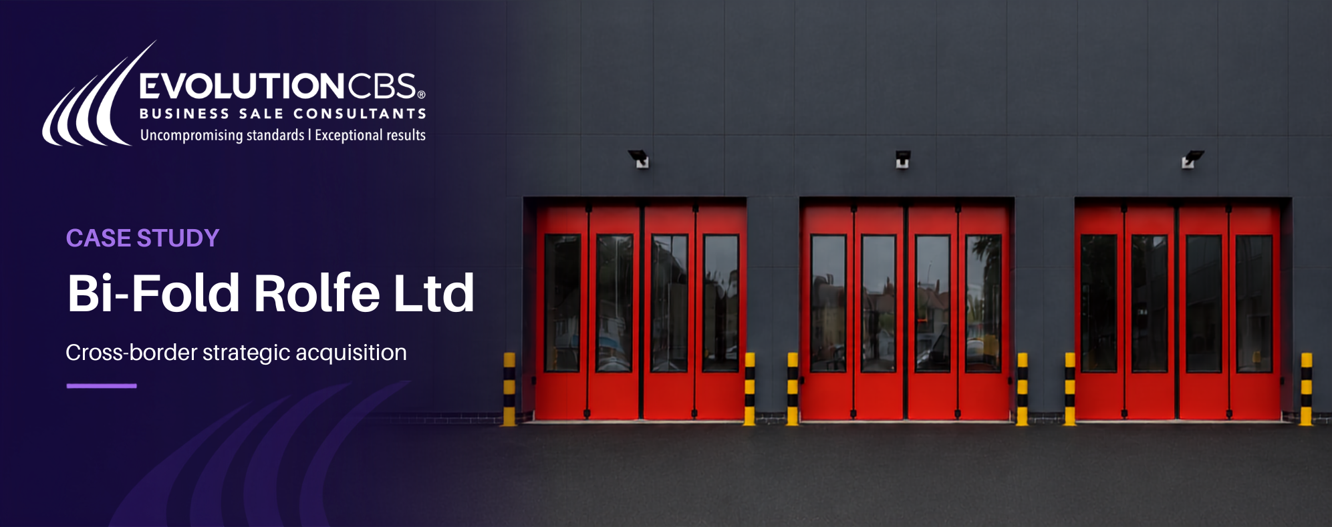
EvolutionCBS advised the shareholders of Nexstor ltd ON IT’S SALE TO everything tech group.
DEAL SNAPSHOT
Client Nestor
Buyer Everything Tech Group
Shareholders Rob Townsend
and Troy Platts
Deal Type
Trade Acquirer, PE Backed
Sector Data Storage and
Hybrid Cloud
COMPANY OVERVIEW
SHAREHOLDER OBJECTIVES
Nexstor Ltd is an award-winning 'full stack' data storage and hybrid-cloud 'as a Service' solutions provider, with decades of experience designing, installing and managing on-premise server, storage and backup solutions.
Established in 2004, Nexstor Ltd built a trusted brand within the Enterprise IT sector over more than twenty years under owners Rob Townsend and Troy Platts. In recent years the business evolved its proposition into managed services and bespoke hybrid-cloud IT solutions, helping clients protect critical applications and data.
The Company has established partnerships with global technology leaders, such as HPE, Veeam, Dell, EMC, VMWare, Spectralogic and Seagate. In 2021, the Company attained HPE Hybrid Gold Partner status and is the only UK reseller to sit on four different HPE worldwide advisory boards.
The business had a robust organisational structure, headed up by a vastly experienced senior management team which runs the operational aspects of the business.
The deal was supported by Independence Capital.
The founders set out with the objective finding an investor who could build on years of consistent success and drive the Company's evolution from reseller to full-service provider.
“Our clients, Rob and Troy, had built an impressive business in Nexstor Ltd and were
seeking the right strategic partner to help take their proposition forward to the next level.
Everything Tech Group really understood the opportunity that Nexstor represents and were the ideal partner. It’s been an honour to go on the journey with Nexstor… we wish you all the best for the future.”
Mike Whittle, Managing Director, EvolutionCBS
www.evolutioncbs.co.uk
1/2

Slide 2
“After over twenty years of building Nexstor and establishing such a trusted brand within
the Enterprise IT sector, priority number one for us was finding an investor who was the
right cultural fit. Evolution CBS came recommended and took the time to understand our business. When we sat down with Everything Tech Group, it quickly became apparent that we had found a team with synergistic values and a shared culture. We would like to thank Mike Whittle from EvolutionCBS for his constant help and advice throughout this process.”
Troy Platts, Owner, Nexstor
THE PROCESS
124
Companies
Profiled & Contacted
Following a detailed Discovery Meeting with our Clients, and an in-depth financial analysis of the business, the EvolutionCBS team prepared the Information Memorandum and a targeted list of 124 potential acquirers comprising strategic and financial buyers.
EvolutionCBS recognised the likely interest we would see from both trade and financial investors attracted to this rapidly growing, resilient sector. This favourable market backdrop, combined with our client’s business performance and readiness, instilled confidence in our deal team.
Our research also identified several Financial Investors/Private Equity firms that were focussed on creating ‘platform businesses’ where they could create an enlarged entity through what is often referred to as a “buy and build” strategy.
With this in mind, we advised the owner to ‘keep an open mind’ about whether to remain vested in the business as it approached its next phase of growth under new ownership.
With offers received from 6 companies, the successful bidder was The Everything Tech Group of companies, an award-winning UK managed services provider (MSP), specialising in four business IT areas: Cloud and Remote Desktop, Networks and Security, Voice and Contact Centre, and IT Support. The Group serves clients in the Accountancy, Legal, and Financial Services sectors, and provides tailored solutions in Technology and Cyber Security for regulated.
70
Information
Memoranda Requested
“Following a successful 20 years building Nexstor, Troy and I really needed to find a
good home for the company. Thanks to Mike and his team at EvolutionCBS, we found the perfect home at EverythingTech, who bring extensive experience to the table and understood Nexstor - our skills, culture, and personalities. We’re excited to help steer Nexstor into the next chapter with EverythingTech.”
Rob Townsend, Owner, Nexstor
13
Potential Investor Meetings
“My experience in M&A has taught me many lessons, but one stands out above all:
culture fit matters. The Nexstor team are a natural fit for the business, bringing a loyal
client base, deep technical expertise and a strong drive to keep evolving. I’m confident
they’ll be a valuable addition to the Group as we continue to grow.”
Mark Allen, CEO, Everything Tech Group
6
Offers Shortlisted
www.evolutioncbs.co.uk
2/2

